Slide 1
A PROJECT PRESENTATION ON ONLINE-VOTING SYSTEM
DEVELOPED BY:
P.VENKATESH SAI(210001049)
N.SAI TEJA(210001046)

Slide 2
AGENDA
Introduction​
Primary goals
​Areas of growth
Timeline
​Summary​

Slide 3
Introduction
An online voting system(OVS) is a software platform that allows groups to securely conduct votes and elections. High-quality online voting system balance ballot security, accessibility, and the overall requirements of an organization’s voting event.

Slide 4
PRIMARY GOALS
Electronic voting technology intends to speed the counting of ballots, reduce the cost of paying staff to count votes manually and can provide improved accessibility for disabled voters.

Slide 5
MEET OUR TEAM
Venkatesh sai
Sai teja
President
Wise-president

Slide 6
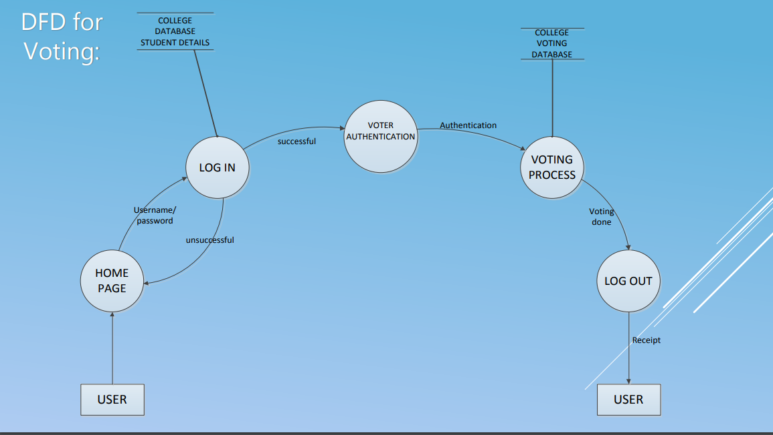

Slide 7
SCOPE.??
It provides website with related information to visitors.
It provides login facility to voters and admin.
Casting vote is possible only after authentication of voter
Admin can generate result with a click.

Slide 8
TIMELINE
sept 2022
Oct(mid) 2022
Oct 2022
7-NOV 2022
10-Nov 2022
Build the HTML
File for OVS
Use of css and preparing the ER-diagram for
OVS
Creating the online sample webpage using Django
Combining the backend part to frontend
Adding the SQLlite to project as database
And final presentation

Slide 9
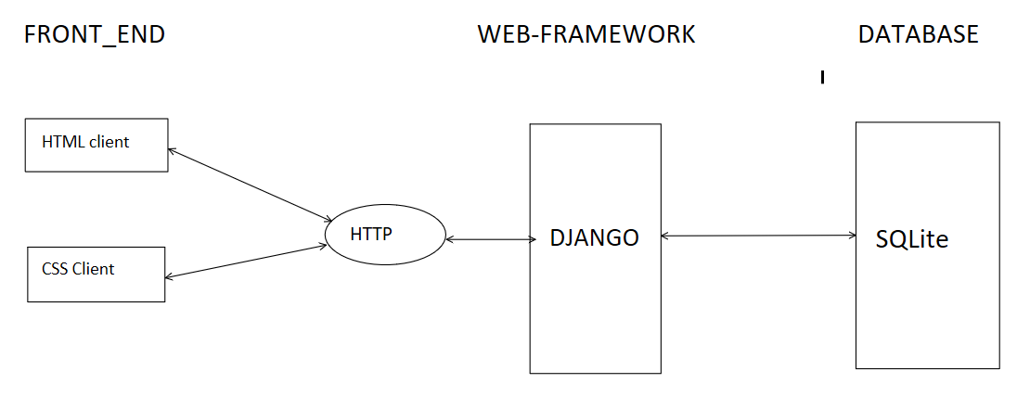
System architecture

Slide 10
AREAS OF FOCUS
IMPROVEMENT IN EXISTING SYSTEM
CLOUD-BASED OPPORTUNITIES
The Existing System of Election is running manually. The Voter has to Visit to Booths to Vote a Candidate so there is wastage of Time.
As we knew that Government of India contain multiple elections. So we are implementing our system such that voter can select election and submit their vote region/ward wise.
Visualize customer directed convergence
Online Voting System can be implemented, using login which requires a username and the name of the candidate
Establish a management framework from the inside

Slide 11
SUMMARY
Online Voting Systems have many advantages over the traditional voting system. Some of these advantages are less cost, faster generation results, easy accessibility, accuracy, and low risk of human and mechanical errors.
Future development focused to design a system which can be easy to use and will provide security and privacy of votes on acceptable level by proper authentication and processing section. It is easy to use and it is less time consuming. It is very easy to debug.

Slide 12
THANK YOU
VENKATESH SAI​
SAI TEJA
venkateshparvathreddy@gmail.com
saitejanunemunthala@gmail.com

